Slide 1
Exception
While creating and executing python program things may go wrong at two different stage .During compilation and during execution time.
Errors that occur during compilation time are called Syntax error.
Error that occur during execution time are called Exception
Syntax Error:
Means: program is not as per the language grammar.
Reported By interpreter/compiler/
Example : Leaving out Symbol, such as colon, comma, bracket.Misspelling keywordIncorrect indentation,Incorrect number of positional argument.
Exception:
if thing go wrong during execution time.
Means: Something unforeseen happened
Reported by: python run time

Slide 2
Exception
An exception is an error which happens at the time of execution of a program. However, while running a program, Python generates an exception that should be handled to avoid your program to crash
The exception indicates that, although the event can occur, this type of event happens infrequently. When the method is not able to handle the exception, it is thrown to its caller function. Eventually, when an exception is thrown out of the main function, the program is terminated abruptly.
Common Examples of Exception:
Division by Zero
Accessing a file which does not exist.
Addition of two incompatible types
Trying to access a nonexistent index of a sequence
Removing the table from the disconnected database server.
ATM withdrawal of more than the available amount

Slide 3
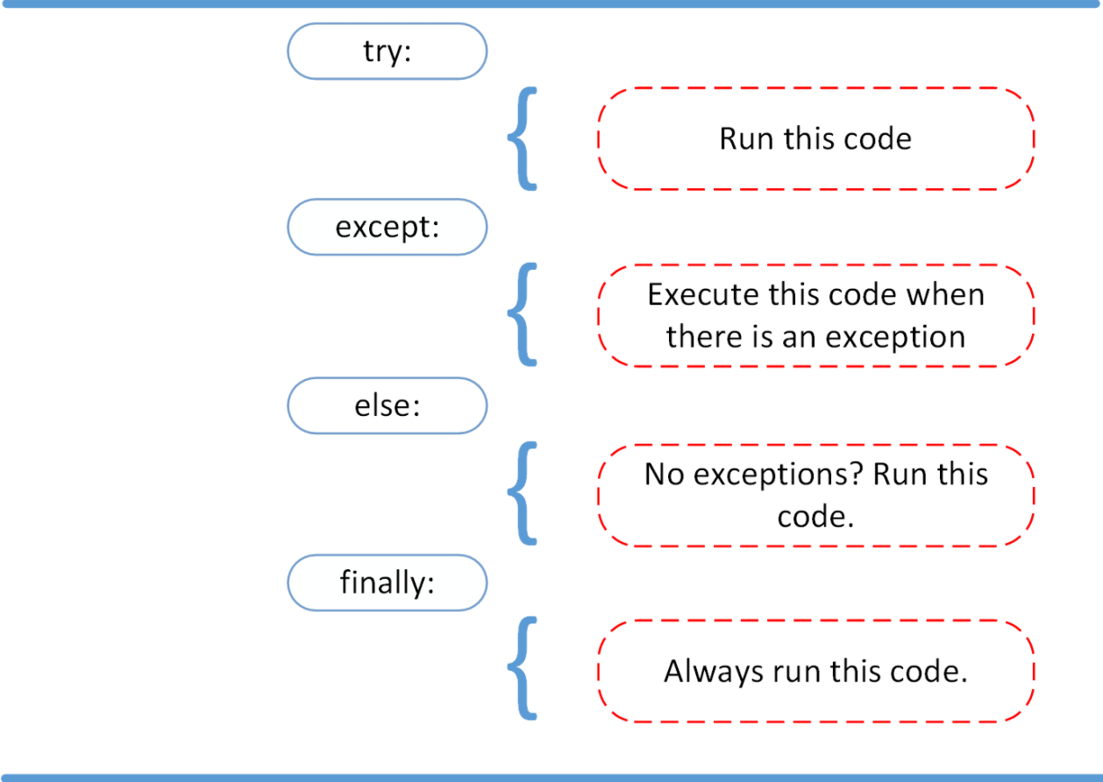
Python Exception Handle

Slide 4
Some Python Errors
Exception | Description
ArithmeticException | Arithmetic error, such as divide-by-zero.
ArraylndexOutOfBoundsException | Array index is out-of-bounds.
IndexError | An IndexErroris raised when you try to refer a sequence which is out of range.
ClassCastException | Invalid cast
ClassNotFoundException | Class not found
InstantiationException | Occurs when you attempt to create an object of an interface or abstract class.
Illegal AccessException | Access to a class is denied.
Access to a class is denied.

